Slide 1
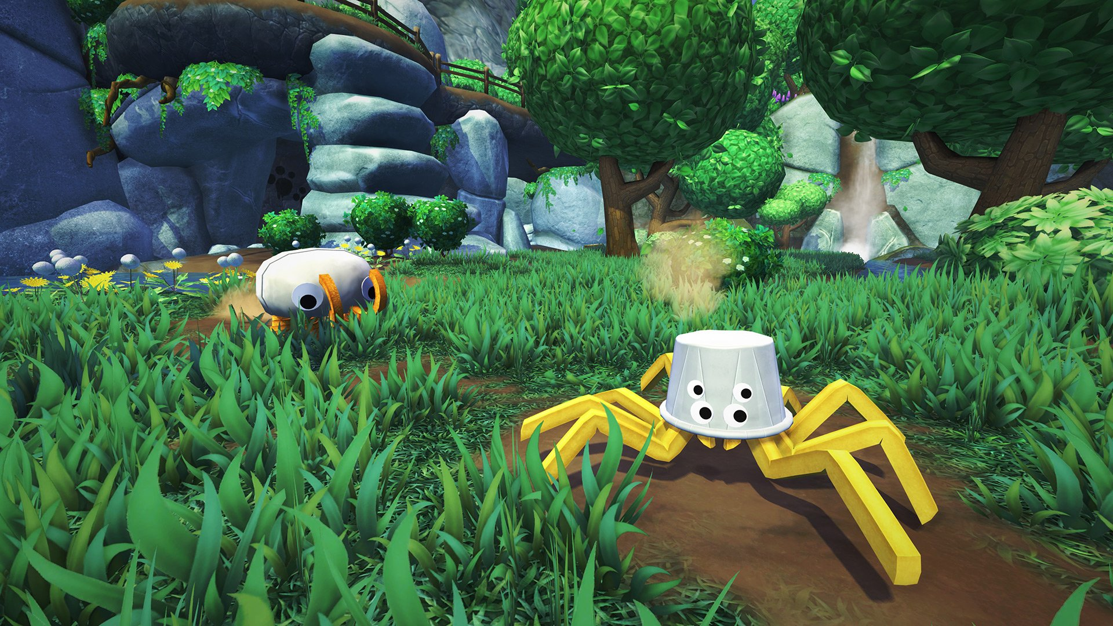
Class 2
Announcements

Slide 2
Text
To draw text
camera->setUI(true)
1 unit = 1 pixel
Positions are pixel offset from bottom left of the screen
g->setMaterial(...)
g->drawText(“Hello, world”, 100)
To increase font resolution
Change fontResolution variable in engine/graphics/Font.h
Each character is 100 pixels tall
Notes:
Make it more easy to draw two dimensional objects directly onto the screen
Such as text

Slide 3
Handins
Since we have had some issues with FastX, you do not need to check whether your handin compiles on the department machines
All you need to do now is write what OS, Qt version, and compiler you are using in your README

Slide 4
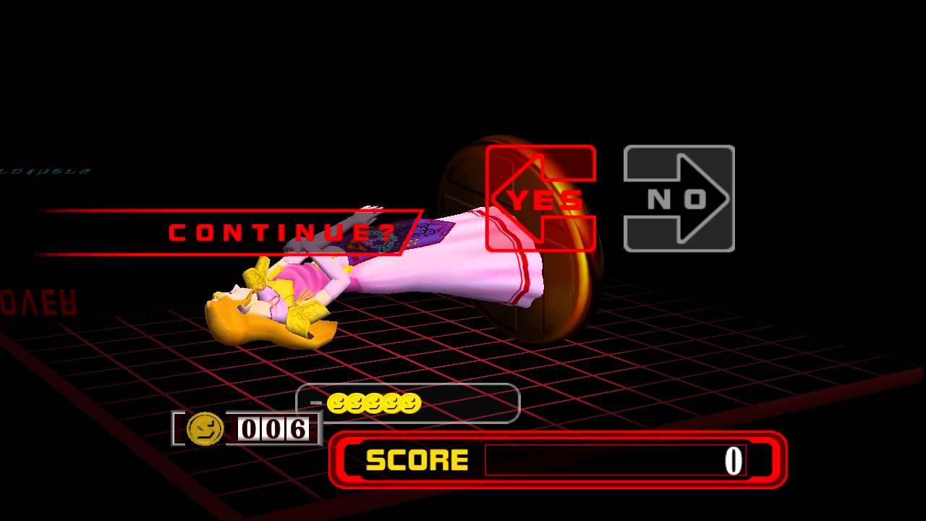
Didn’t Complete Warmup1?
No problem – you have retries!
Don’t let the snowball begin week 1
Try to do your retry AND Warmup2 this week!

Slide 5
Collaboration Policy
Remember to sign the collaboration policy on the website
Pretty vanilla collaboration policy
No sharing code
No looking at each other’s code
Can discuss design

Slide 6
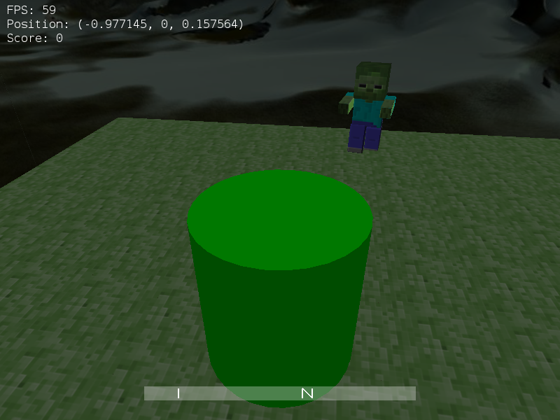
Warmup2 - Your first full game!
You’ll have your first full 3D game after this week!
Gameplay options are actually pretty diverse
More on this later
Have some fun!

Slide 7
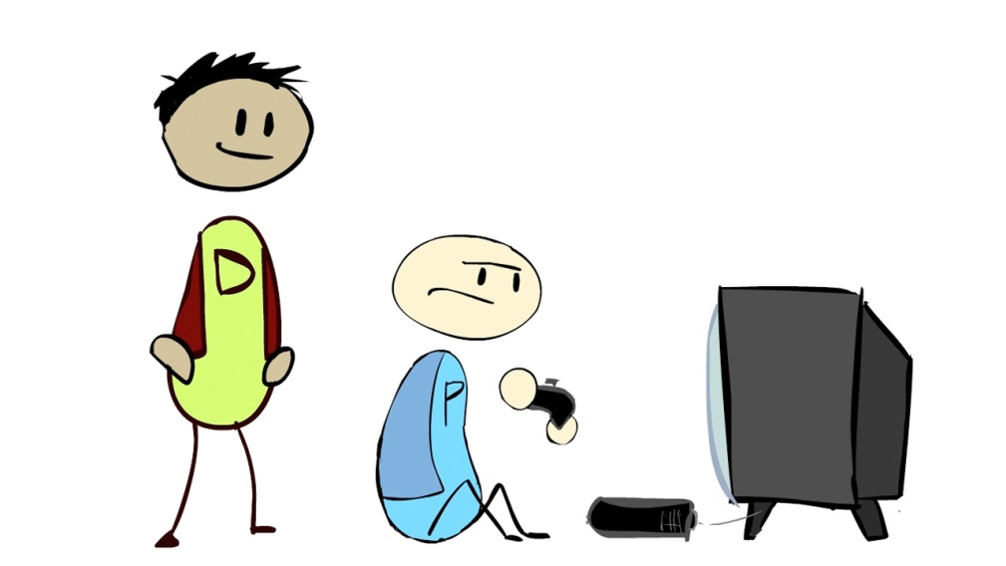
Playtesting
First playtesting session this week!
Each of us will give a short demo of our work for Warmup 1

Slide 8
Playtesting
Play as a player:
What did they do that you like?
What did they do that you didn’t like?
Play as an engineer:
Can you find any bugs? Can you reproduce them?
Do you understand how their systems work?

Slide 9
Playtesting
Quality > quantity for feedback
“I like X” is nice, but “I like that X uses Y to do Z” is much better
“It crashed” is useless, but “It crashed when I did X after doing Y, but didn’t when I did X after doing Z” is SO helpful
Notes:
Be more detailed with your feedback

Slide 10
Questions?
Announcements

Slide 11
Class 2
Third Person Camera

Slide 12
The Third Person camera
Third-Person Camera

Slide 13
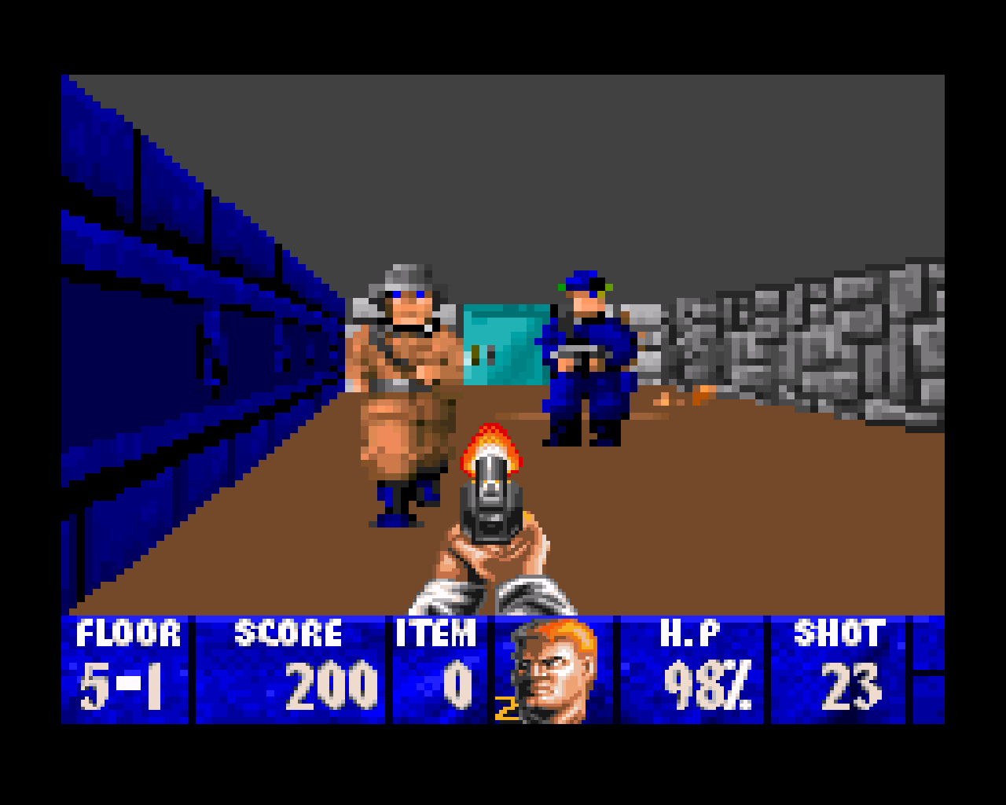
First Person is easy
Field-of-view is limited
Actions are (almost) always happening in the direction the player is looking
It’s how we see the real world

Slide 14
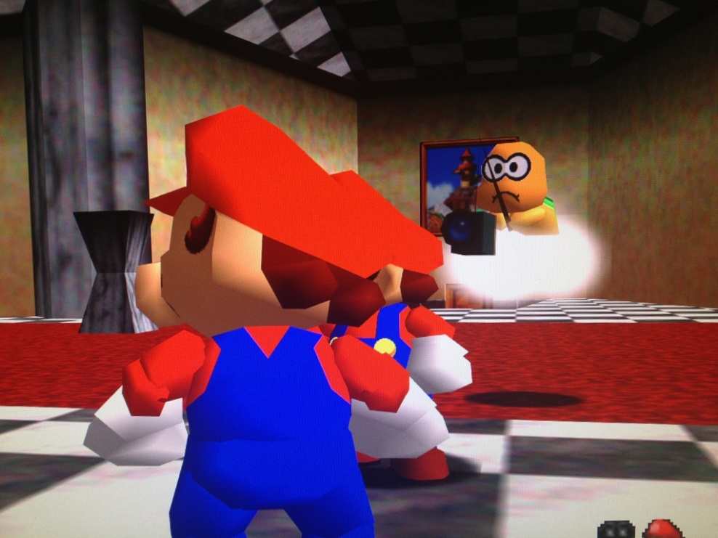
Third Person is tricky
Field of view is ambiguous – player can often see:
Behind themselves
Around corners
Through walls
Player can perform actions without turning
Fighting sequences
We don’t see the real world this way

Slide 15
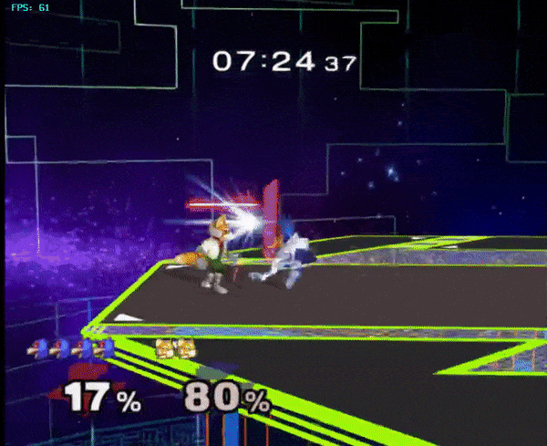
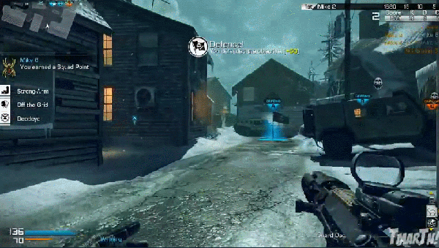
What works best?
Player controls the camera?
Camera controls itself?

Slide 16
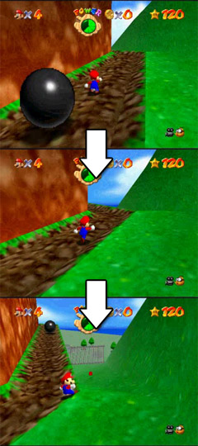
Combine the two?
Camera automatically turns to keep player in focus as well as possible
Player can manually change the camera if they want a particular camera angle

Slide 17
The Simplest Solution
Take the first person camera
Translate the eye back along the look vector
Pros:
Easy to toggle between 1st and 3rd person cameras
Easy to change zoom level by scaling translation
Cons:
Awkward camera controls (pitch and yaw don’t always feel quite right)
Sometimes clips through walls (can use raycasting to circumvent this, but we’ll get to that another day!)

Slide 18
Questions?
Third Person Camera

Slide 19
Class 2
Game World

Slide 20
Motivation
Game World

Slide 21
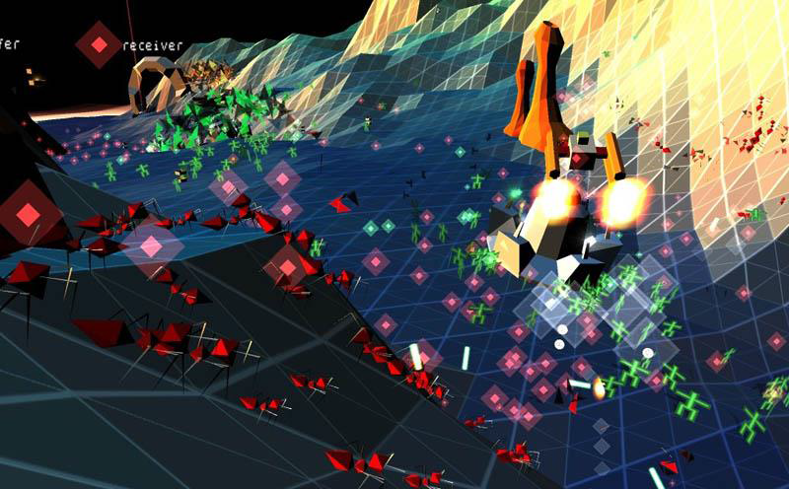
Games are busy…
All games involve a number of game objects
May be many different types of objects
May be many instances of the same type of object
Maybe both of the above
These objects exist in their own universe
If our entire universe is a game, you’re a game object

Slide 22
Games are busy…
We need to take the burden of representing and organizing these objects off the game code
Otherwise, have to re-implement for every game we build
Notes:
Because all games have objects

Slide 23
High Level Representation
The GameObjects
The GameWorld
Small collections of functionality
Hold their own logic and state
The overarching collection of GameObjects
Responsible for global logic and facilitating interactions between GameObjects
Notes:
How we’re going to organize objects and define in our engine is as follows
Game Objects have some idea of who they are, but not who others are
Game World knows how Game Objects are supposed to interact

Slide 24
Questions?
Game World

Slide 25
Game objects
Game World

Slide 26
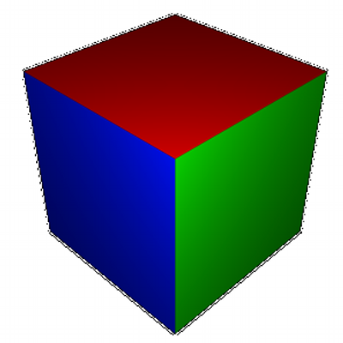
What is a GameObject?
Environment
Player
Enemies
Much more!
How do we implement them?
Notes:
How do we want to implement a game object in our code?

Slide 27
Hierarchical GameObject design
Consider a simple game with:
Player
Enemies
GameObject
Player
Enemy

Slide 28
Hierarchical GameObject design
They both move and have health bars
Some behavior specific to Player
Some behavior specific to enemies
GameObject
Position
Health bar
Player
Key controls
Enemy
AI

Slide 29
Hierarchical GameObject design
Let’s add a new type of object: Destructible Terrain
Has a health bar
Doesn’t move
Time to abstract out some more
GameObject
Health bar
Units
Position
Terrain
Terrain shape
Player
Key controls
Enemy
AI

Slide 30
Hierarchical GameObject design
Let’s add Invincible Enemies
No health bar
They move
Now we reach a problem
Where do our invincible enemies fit in?
GameObject
Health bar
Units
Position
Terrain
Terrain shape
Player
Key controls
Enemy
AI

Slide 31
Hierarchical GameObject design
Attempt 1: Can make a separate class and re-implement moving and AI
GameObject
Damageable
InvincibleEnemy
Position
AI
Units
Terrain
Player
Enemy

Slide 32
Hierarchical GameObject design
Attempt 2: Can subclass enemy and add code to hide the health bar
GameObject
Units
Terrain
Player
Enemy
InvincibleEnemy

Slide 33
Hierarchical GameObject design
Both not ideal
Attempt 1: Re-implementing code
Attempt 2: Unused superclass functionality in subclass (not good practice)
With hierarchical design, often have to make these lose-lose design decisions
Notes:
Hierarchies with lots of objects tend to have this problem of fitting things in, having to make bad design decisions

Slide 34
Solution
Component-based design
GameObject
?

Slide 35
Solution
GameObject
List of Components
GameObjects are just lists of components
The components implement all relevant functionality
The appearance and logic of each object is defined by its components
objects can be any combination of components
Making new objects is as easy as adding new components
HealthComponent
Health bar
PhysicsComponent
Updates position
DrawComponent
Has a Shape, Material
AIComponent
Makes decisions
PlayerControlComponent
Responds to key presses
Notes:
Can create game objects with any combination of these components. Problem we had before of an enemy without health bar is easily solved

Slide 36
GameObject Contract
GameObjects need to do the following:
Add a component
Remove a component
Get a component
Notes:
Their lists of components, but what do they need to do? Need to do the following.

Slide 37
GameObject Contract
class GameObject {
public:
void addComponent(...);
void removeComponent(...);
Component getComponent(...);
private:
Container<Component> m_components;
}

Slide 38
Component Contract
Nearly all Components need to update
onTick
Where most logic is implemented
Some Components respond to other events
For example onDraw
Components might want to access parent GameObject
So that they can talk to other components of the same GameObject
Notes:
Want modular things which can be added to any game object to store functionality.

Slide 39
Component Contract
class Component {
public:
void onTick(float seconds);
// more events (possibly in subclasses)
private:
GameObject *m_gameObject;
}

Slide 40
Questions?
Game World

Slide 41
Class 2
Cylinder-Cylinder Collisions

Slide 42
Cylinder-Cylinder Collisions
Collisions I

Slide 43
Parts of a collision
Detection
Are two shapes overlapping?
Resolution
Make them not overlapping anymore
Response
Make them bounce off each other in some believable way

Slide 44
Why do we need it?
(Almost) every 3D game uses it
Even last week, you did this with the floor
Is pos.y < 0? (detection)
If so, make pos.y = 0 (resolution)
Set the player’s y velocity to 0 (response)

Slide 45

Cylinders
Cylinders make great collision shapes
People are kind of cylinders
The math is pretty easy
Turning in place doesn’t change your collision shape

Slide 46
Concept
Separate 3D problem into 2D and 1D problems
2 + 1 = 3
Overlapping if both:
Bases overlap in xz plane
Heights overlap on y axis
Easy if your cylinder is represented by a point (bottom center) and dimension (radius, height)
Notes:
* Cylinder’s don’t rotate

Slide 47
Concept
Need to find minimum translation vector (MTV)
Minimum Translation Vector – shortest possible translation to get two shapes out of collision
With respect to one of the shapes in collision

Slide 48

Concept
Either translate in xz plane or in the y direction
Only 2 possible MTV’s
Pick the one that is shorter
Translate red out by $\frac{1}{2}mtv$ and blue out by $−\frac{1}{2}mtv$
If your engine supports immovable game objects, the movable game object is translated out by the entire MTV

Slide 49

Circle Math
Two circles are overlapping if and only if:
$\left(blue.pos−red.pos\right).length()<blue.radius+red.radius$
Avoid square root by squaring expression!
$\left(blue.pos−red.pos\right).lengthSquared()<{(blue.radius+red.radius)}^{2}$
Notes:
Length involves a square root which can be expensive

Slide 50

Computing Circle MTV
MTV (in the direction of red):
$len=\left(blue.pos−red.pos\right).length()$
$\frac{\left(red.pos−blue.pos\right)}{len}∗\left(\left(blue.radius+red.radius\right)−len\right)$

Slide 51

Line Math
Two 1D line segments are overlapping if and only if both of the following are true:
$blue.min<red. max$
$red.min<blue.max$

Slide 52
Computing Line MTV
float intervalMTV(Interval a, Interval b)
float aRight = b.max - a.min
float aLeft = a.max - b.min
if aLeft < 0 || aRight < 0
return -1
if aRight < aLeft
return aRight
else
return -aLeft

Slide 53
Collision Response
If objects collide, they should do something
Minimally, translate by ½ the MTV each
Adds up to 1 full MTV!
In almost all cases, do game-specific logic
Example: bullet collides with player
Player takes damage
Player is moved back some by the force of the bullet
Bullet is destroyed

Slide 54
Questions?
Collisions I – Cylinder-Cylinder Collisions

Slide 55
Class 2
Systems

Slide 56
Motivation
Systems

Slide 57
Example: Collision Logic
We know how to detect if cylinders are overlapping
We have a bunch of GameObjects
How do we make them collide with each other?

Slide 58
Example: Collision Logic
We could put collision logic in the GameWorld
GameWorld checks if each pair of collidable GameObjects is colliding
GameWorld tells GameObjects that they there are colliding
Components of GameObjects respond appropriately
Sounds pretty good

Slide 59
Global Logic
What if your GameObjects play sounds?
Should we put sound logic in the GameWorld too?
GameWorld tells each GameObject that can play a sound to do so

Slide 60
Global Logic
What if other GameObjects require more global logic?
We would have to add all of our logic to the GameWorld class
Before long, our GameWorld can get pretty bloated …

Slide 61
Systems
Introducing Systems …
Systems implement global logic
Each System stores a list of interested objects (usually GameObjects or Componentss) and calls relevant methods on each of them
Other examples
DrawSystem calls draw(Graphics *g) on it’s drawable components
CollisionSystem checks collisions + calls collide(glm::vec3 mtv) on collision components
SoundSystem calls playSound(...) on sound components

Slide 62
Implementation
Systems

Slide 63
Storing GameObjects vs. Components
You could have your Systems keep track of either a list of GameObjects or a list of Components—it’s up to you
Storing GameObjects makes it easier to access multiple Components of the GameObject and reference GameObject specific state
Storing Components avoids potential type headaches and can give you performance benefits

Slide 64
System Contract
class System {
public:
void onTick(float seconds) {
for(GameObject/Component obj : m_objects)
{
// Update objects
}
};
// more events (possibly in subclasses)
private:
Container<GameObject/Component> m_objects;
}

Slide 65
What about the GameWorld?
GameWorld should hold Systems as well as GameObjects
With GameObjects/Components:
The appearance and logic of each object is defined by its components
With GameWorld/Systems
The global logic and interactions between objects in the world are defined by its systems

Slide 66
(Possible) GameWorld Contract
class GameWorld {
public:
void tick(float seconds);
void draw(Graphics *g);
//...
private:
Container<GameObject> m_objects;
Container<System> m_systems;
}

Slide 67
Questions?
Systems

Slide 68
Class 2
Handling Input

Slide 69
Last time…
Right now, you might be handling input like this:
void onKeyPressed(QKeyEvent *event) {
if (event->key() == Qt::Key_W) //move up
if (event->key() == Qt::Key_S) //move down
...
}

Slide 70
The Problem
Qt events may not act like you would expect
The onKeyPressed event fires rapidly for the duration a key is held
Think of when you press down a letter key in Microsoft Word

Slide 71
The Result
Movement happens in short bursts
We move a little bit every time a key event fires from the system
Result: jerky movement—not ideal!
What we want is something smooth and continuous

Slide 72
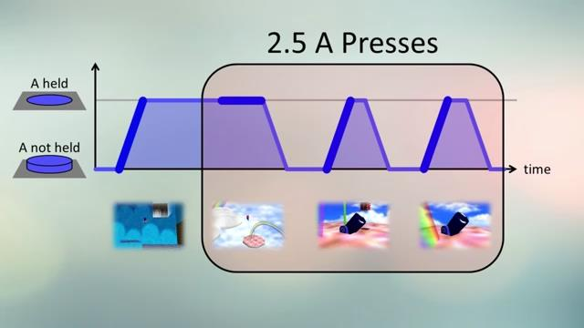
The Solution
A key has two states: pressed and not pressed
This is represented in the event system by KeyPressed and KeyReleased events

Slide 73
The Solution
Instead of moving on every single KeyPressed event, just pay attention to first one
Until the KeyReleased event, move the player every tick
Keep track of the current state of each key in some sort of data structure of Booleans
For example, Map<int, bool>

Slide 74
But wait, there’s more!
In general, it’s useful to access the current state of input …
Keys that are pressed
Mouse buttons that are pressed
Mouse position
Not just when the current state changes
Input object that stores all of this information?
Up to you—be creative!

Slide 75
Questions?
Input

Slide 76
Class 2
Tips for Warmup 2

Slide 77
Warmup 2 Design
This week, design is everything
Many ways to approach GameWorld, System, GameObject, Component design
Even with the contracts we gave you
For example …
Systems can store GameObjects or their Components
Plan out your design, and talk it through with TAs

Slide 78
More Design Tips
GameWorld and GameObject
Should be defined engine side
Should not be subclassed game side or engine side
System and Component
Should be defined engine side
Can be subclassed game side or engine side

Slide 79
Your First Components (Suggested)
DrawableComponent
Holds shape, material
TransformComponent
Holds position, size of object
CollisionComponent
Holds collision cylinder
PlayerControlComponent
Responds to player input
Player/EnemyResponseComponent
Does something in response to collision

Slide 80
Your First Systems (Suggested)
TickSystem
Ticks the objects that it holds
DrawSystem
Draws the objects that it holds
CollisionSystem
Checks for collisions between objects
Notifies objects that they have collided

Slide 81
Destroying Game Objects
Your Warmup 2 game needs to have a reset feature
You must clear the gameworld when you reset
Think about what would happen if a gameobject G managed by a shared_ptr called a method destroySelf(), which removes all shared_ptr references to G in the gameworld
The number of references to the shared pointer goes to 0, and then the shared pointer is destroyed!
But we are inside of one of G’s methods, so we get a segfault!
Think about what you could do to bypass this problem

Slide 82
Entity Component System Typemap
Given a gameobject, what is the best way to access its components?
We could have some function like Component getComponent(std::string s)
This is okay, but if we wanted to access any methods of a CollisionComponent that are not virtual functions in the abstract Component class, we would need to cast the Component to the CollisionComponent class

Slide 83
Entity Component System Typemap
We can use some C++ tricks to create a typemap
There is a typemap implementation in src/engine/utils/TypeMap.h
Look at this article for an explanation of the code!
Feel free to ask about how the typemap code works!

Slide 84
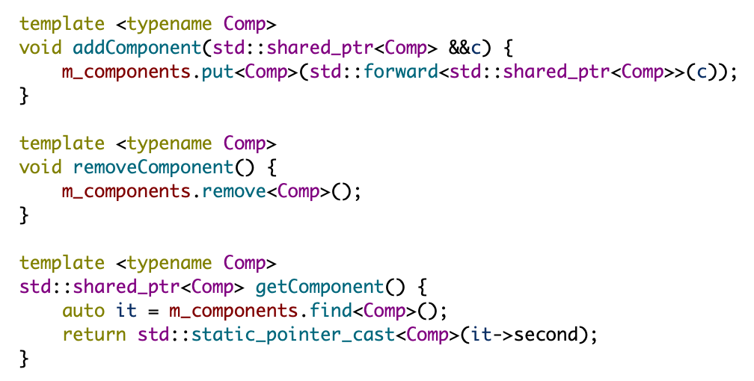
Entity Component System Typemap
You can use the typemap in your GameObjects like this (assuming we have a TypeMap<std::shared_ptr<Component>> called m_components

Slide 85
Entity Component System Typemap
And then we can ask a gameobject for its components like this…
No casting required! (It’s covered by the GameObject class)
We can add extra assert statements to make sure our typemap is consistent

Slide 86
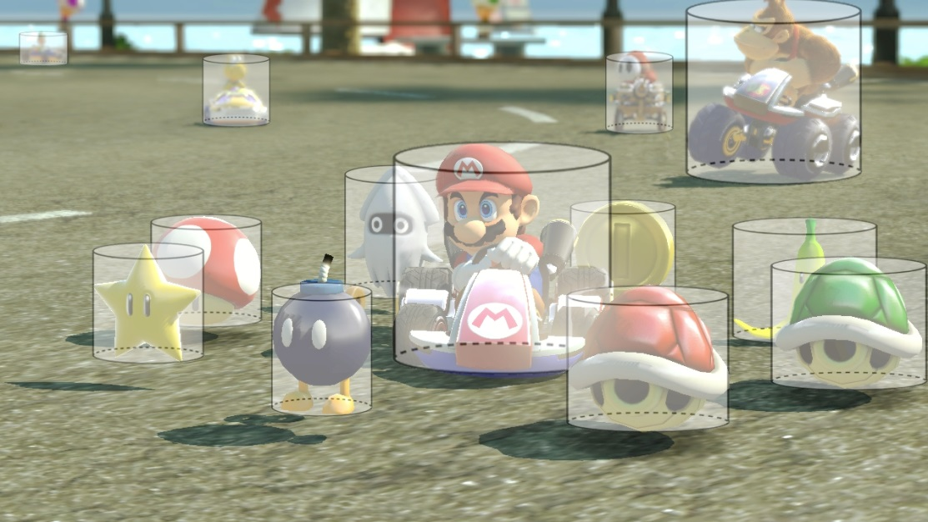
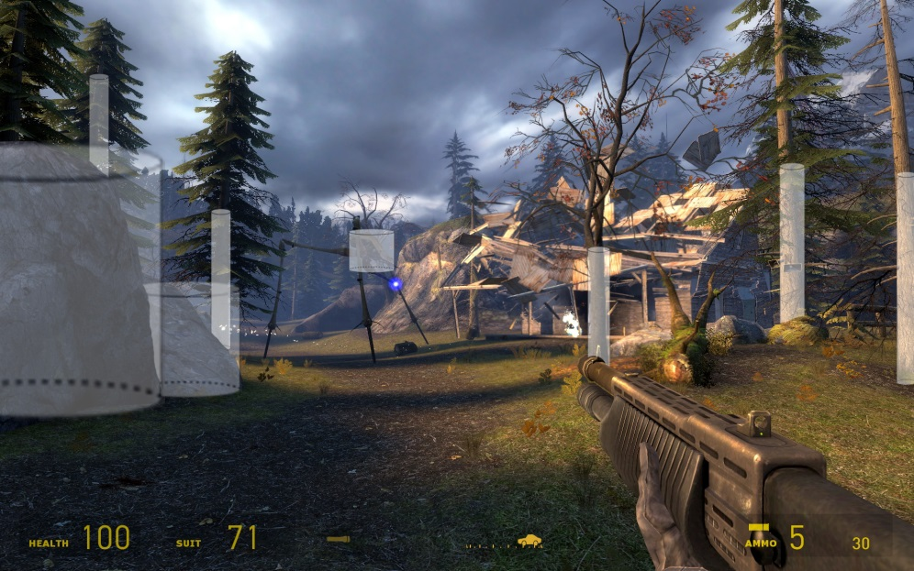
Cylinders
What are they good for?
Absolutely nothing
Notes:
Inter-entity collisions
Basic terrain
bullets

Slide 87
Questions?
Tips for Warmup2

Slide 88
Class 2
C++ Tip of the Week

Slide 89
Forward Declarations
C++ Tip of the Week

Slide 90
Forward Declarations
What is declaration (as opposed to definition)?
Just enough information to tell the compiler ‘this exists’
For a function, it would be the type signature:
int add(int a, int b);
For a class, it’s just the name:
class Number;
When you #include a header, you’re defining that class
Notes:
* Maybe provide example of forward declaration if asked for

Slide 91
Forward Declarations
When do we actually need to #include a class?
If this class extends that class
If it has a non-pointer member variable to that class
That means we don’t need to #include classes of:
Pointer member variables
Function arguments & return types (pointer or non-pointer)

Slide 92
Forward Declarations
When should we use forward declarations?
For every class, in every header file, that you possibly can
There is no benefit to including a whole class when you only need the declaration
You can put the #include in the .cpp file instead

Slide 93
Benefits of Forward Declaration
Fewer circular dependencies
These happen when two classes rely on each other, and both attempt to define the other by #including headers
If the link is indirect, it will take much longer to track
Significantly reduced build times
Every time you #include a header, it also then #includes all the headers #included by that header, and so on
Game engines are huge, and this problem multiplies per file

Slide 94
Questions?
C++ Tip of the Week

Slide 95
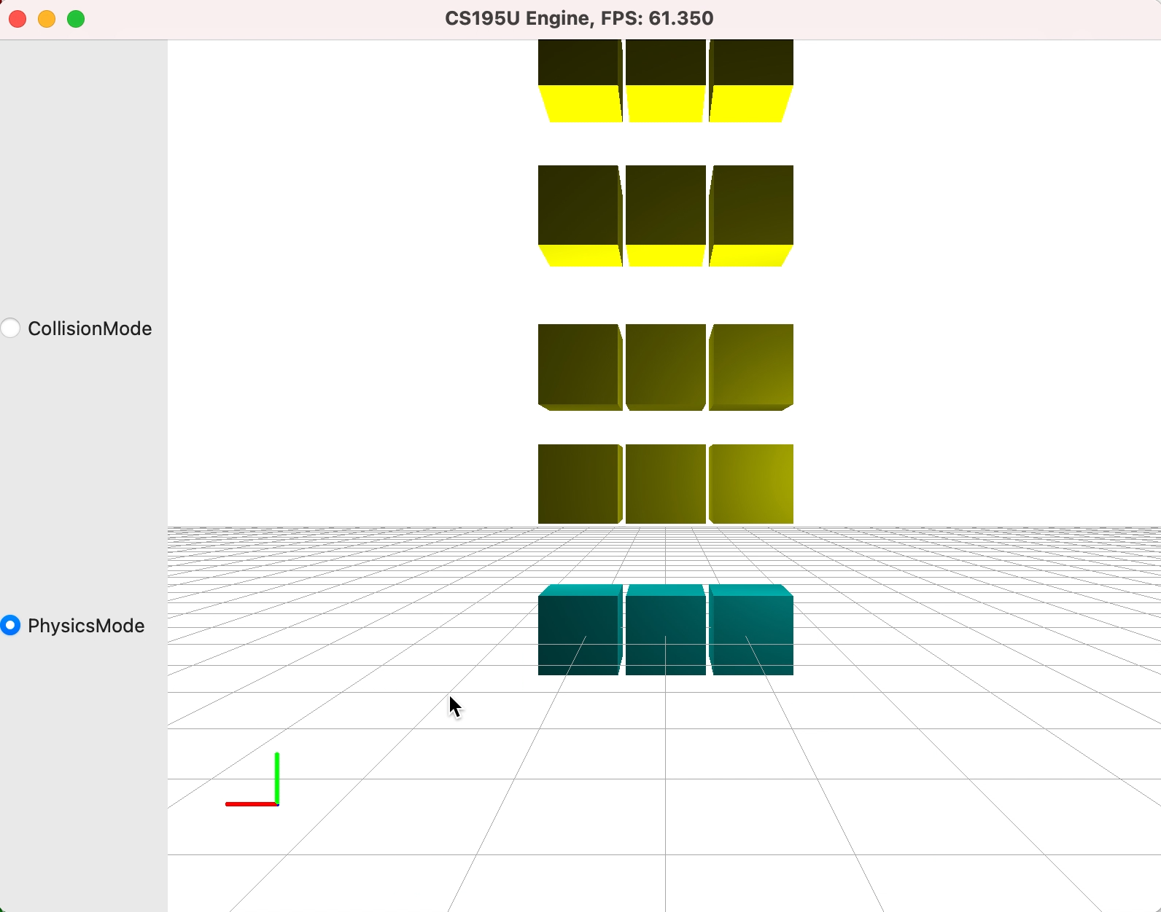
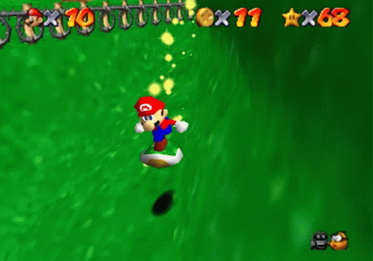
Next Week…

Slide 96
Class 2
Good luck on Warmup 2!

Slide 97
System Contract
All Systems need to
Add GameObjects
Remove GameObjects
Nearly all Systems need to update
onTick
This is where most global logic takes place
Some Systems need to draw
onDraw

Slide 98
GameWorld Contract
GameWorlds need to do the following:
Add/remove/get GameObjects
Add/remove/get Systems
tick and draw Systems

Slide 99
Warmup 2 Design: Systems
Your choice of when to add GameObjects to Systems
On instantiation
On addition to the GameWorld
Your choice of how to add GameObjects to Systems
Manually, for example:
tickSystem.addObject(obj);
Automatically, for example:
Ask each System if interested in GameObject based on the Components it has

Slide 100
responsibilities
Game World

Slide 101
What does a world do?
Centralizes object management
Maintains list of GameObjects
Methods for adding and removing GameObjects
Tells GameObjects to update
Unit
Unit
Unit
Unit
Unit
Unit
Unit
Enemy
Unit
Background
Unit
Unit
Bullet
Boss
Player
GameObjects
World logic
World

Slide 102
GameWorld Contract
class GameWorld {
public:
void tick(float seconds);
void draw(Graphics *g);
void onDDDEEE(DDDEvent *e)
private:
// List of game objects
}

Slide 103
GameObject Contract
class GameObject {
public:
void addComponent(...);
void removeComponent(...);
Component getComponent(...);
private:
List/Map<Component> m_components;
}

Slide 104
Component Contract
class Component {
public:
void onTick(float seconds);
// more events (possibly in subclasses)
private:
GameObject *m_gameObject;
}

Slide 105
New GameWorld Contract
class GameWorld {
public:
void tick(float seconds);
void draw(Graphics *g);
//...
private:
List<GameObject> m_objects;
List<System> m_systems;
}

Slide 106
Systems?
We have a GameWorld
We have GameObjects
We have Components
Do we need anything else?
???

Slide 107
Systems?
Question: How do we pass events to GameObjects and their Components?

Slide 108
Systems?
Solution 1
GameWorld passes events to GameObjects
tick, draw, etc.
GameObjects pass these events to their components

Slide 109
Systems?
Problems with Solution 1
Not all GameObjects respond to the same events
For example, some GameObjects may not have drawable Components

Slide 110
Systems?
Problems with Solution 1
Not all games use the same events
Some events may be game specific
Would have to subclass the GameWorld to put them in your game

Slide 111
Systems?
Solution 2
Organize GameObjects into Systems
Systems pass specific events to GameObjects

Slide 112
Systems
Each System stores a list of relevant Components and forwards events to each of them
For Example
TickSystem forwards tick(float seconds)
DrawSystem forwards draw(Graphics *g)
CollisionSystem forwards collide(glm::vec3 mtv)
SoundSystem forwards playSound(...)

Slide 113
System Contract
class System {
public:
void onTick(float seconds);
void onDraw(Graphics *g);
// more events (possibly in subclasses)
private:
List<GameObject> m_objects;
}

Slide 114
Collisions in Your Game
CollisionComponent
Holds collision shape (cylinder)
CollisionSystem
Check each pair of collidable objects for collision in onTick method
Forward collision callback to colliding objects
ResponseComponent
Collision response callback looks like:
onCollide(glm::vec3 mtv)
Responds to collision

Slide 115
C++ Polymorphism
C++ Tip of the Week #1

Slide 116
Polymorphism in C++
Can we use a variable of type BaseClass to hold a variable of type ChildClass (which inherits from BaseClass)?
Many reasons that this is useful
For example
List of Screens which can hold any type of screen subclass
List of Components which can hold any type of component subclass

Slide 117
Polymorphism in C++
This is possible, but only if …
We have a variable of type BaseClass* (pointer)
The variable points to an object of type ChildClass
Example:
BaseClass* obj = new ChildClass();

Slide 118
Polymorphism in C++
Works with shared pointers too
Example:
std::shared_ptr<BaseClass> obj = std::make_shared<ChildClass>();

Slide 119
Polymorphism in C++
Just like Java, need to cast if want to convert back to ChildClass, or use ChildClass methods
Examples:
ChildClass *childObj = (ChildClass *)obj;
std::shared_ptr<ChildClass> childObj = std::dynamic_pointer_cast<ChildClass>(obj);

Slide 120
Components of a collision
Non-continuous collision detection:
Detection
Are two shapes overlapping?
Resolution
Make them not overlapping anymore
Response
Make them bounce off each other in some believable way
Continuous collision detection:
Analytic detection
Compute where two shapes will overlap
Translation
Translate them to exactly that point
Response
Same as above
Notes:
Cylinder-cylinder is the first
Our other two engines will be the secon

Slide 121
Lecture 2
C++ Anti-Tip of the Week

Slide 122
Fun with Ternary Operators
bool check = frand() > .5f;
int a = (check ? 3 : 4);
int b = (check ? -1 : 1) * 5;
(a > b ? a : b) = 0;
(a < b ? cout : cerr) << (a + b) << endl;

Slide 123
Response
class Component {
public:
Cylinder getCylinder();
void onCollide(Entity *e, Vector3 mtv);
}
Engine gives you callbacks that let you know when an Entity is hit by another Entity
Allows you to appropriately change the velocities of each entity involved
Proportional to the difference in velocities
Exact physically correct collisions for these types of collisions covered in cs1971, come to hours if interested

Slide 124
One last tip…
Hold up your right hand and repeat after us
“I will not”
“check for or respond to collisions”
“in an Entity’s onTick() method”
Tick all your entities, then collide all your entities in the World
“Multi-pass” logic we talked about before
Things will break if you don’t

Slide 125
What isn’t a GameObject?
Up to you
Be suspicious if …
A GameObject doesn’t have a lot in common with other GameObjects
A GameObject interacts with other GameObjects in a very unconventional way
Examples
UI elements (menus, buttons, sliders, etc.)

Slide 126
Expanded Contract
An object should also do the following:
Tick each tickable component
Draw each drawable component

Slide 127
Expanded Contract
public void tick(long b);
public void draw(GraphicsContext2D b);

Slide 128
Systems
System class
Each System stores a list of interested GameObjects and forwards relevant events to each of them
Systems organize shared behavior
For example, not all GameObjects will be drawn
DrawSystem should only hold GameObjects that have Drawable Components
For Example
TickSystem calls tick(float seconds) on GameObjects
DrawSystem calls draw(Graphics *g) on GameObjects

Slide 129
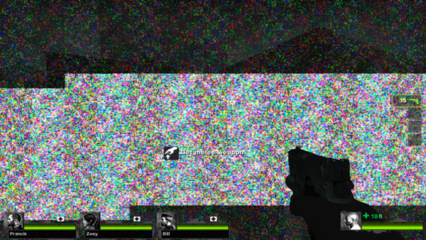
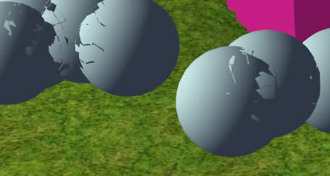
Multi-pass logic
Passing events to GameObjects in the wrong order leads to undesirable behavior
World can selectively update state in order
e.g. tick all GameObjects so they update position, *then* check for collisions

Slide 130
Enforcing Draw Order
Use a TreeSet
log time lookup/insertion/removal
Predictable order (can set priority for drawing)
Adding the same GameObject twice won’t leave a duplicate
Requires custom comparator
Alternatively, set drawing layers

Slide 131
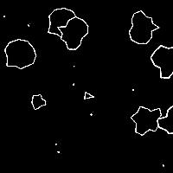
Player motion
Set velocity while keys are held?
Too sudden
Can interact poorly with collisions
Not a huge deal this week, but will be in the future
Apply acceleration while keys are held?
Asteroids style movement!
Still not quite realistic
Most things have a max speed

Slide 132
Player motion
pos += 10; // jerky movement
vel = 10; // constant velocity
pos += vel;
acc = 1;
vel += acc;
pos += vel; // smoother, but not perfect

Slide 133
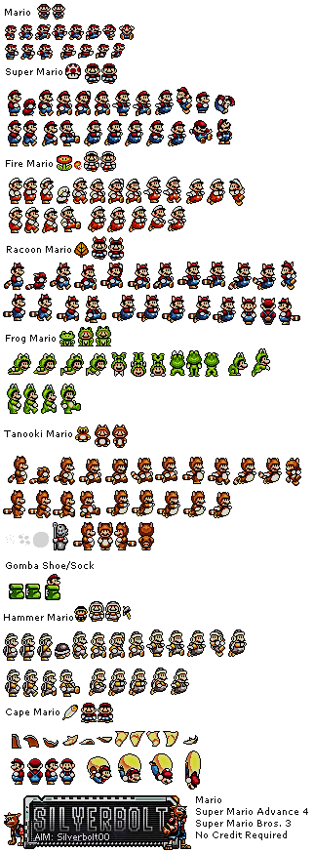
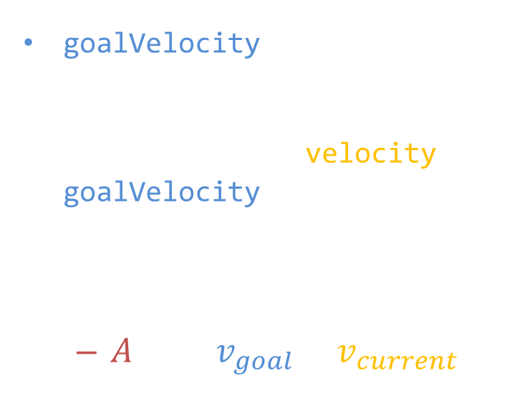
Goal velocity
goalVelocity set directly from arrow keys
Gradually set velocity to goalVelocity
By applying an acceleration
$A=k(v_{goal}−v_{current})$

Slide 134
World Responsibilities
Represents all “entities” in a single space
“Owns” game coordinate system
Centralizes entity management
Maintains list, add/remove via queues, iterating over copy, or a fancy backwards iteration
Backwards iteration and iteration over copy to prevent concurrent modification
Passes ticks and draws to entities
Handles global logic
Anything beyond the scope of a single entity
E.g. providing collision detection callbacks to entities and handling mouse/key/other input events
Unit
Unit
Unit
Unit
Unit
Unit
Unit
Enemy
Unit
Background
Unit
Unit
Bullet
Boss
Player
Entities
World logic
World

Slide 135
Entities
Single logical “object” within the game
Stores all state relevant to itself, e.g. drawing information, collision shape, HP, attack cooldown, etc…
Hierarchical representation
High-level subclasses in engine, low-level in game
Each additional layer adds a specific set of functionalities
Receives events from World
More than just tick+draw!
Entity
Background
Damagable
Bullet
Enemy
Player
Boss

Slide 136
Entity responsibilities
May draw, may not
Spawners, timers, force fields don’t
May use ticks, may not
Static environment, background don’t
Most will probably do both though
Player, enemies, items, pickups, and many more
Player input?
Better handled by World (the boundary between program and game)
Determine collisions with other Entities?
Better handled by World (the collection of all entities)
Respond to collisions with other Entities?
Handled by Entities, allows each Entity to uniquely specify how it responds

Slide 137
What about the environment?
This week, the environment is just the y=0 plane
For minecraft, it will be a bunch of cubes
For platformer, it will be a bunch of polygons
How the environment is represented determines how entities must be represented
For warmup, cylinders work great!
For minecraft, boxes work great!
For platformer, ellipsoids work great!
We can even mix collision systems – more about that in upcoming weeks

Slide 138
Implementation
Game World Representation (Common Engine)

Slide 139
The Entity class
(Almost) every Entity minimally needs to be able to:
Tick (exist in time)
Draw (exist in space)
Since we’re focusing on collisions, it also makes sense for every Entity to have:
Position (as a 3D vector)
Dimensions (as a 3D vector)
This will allow us to determine several types of bounding shapes
Other physics components?
Velocity, acceleration are incredibly useful and trivial to implement
Mass, force, and impulse are a bit trickier (we won’t be implementing them in this class)

Slide 140
The Entity class
class Entity {
public:
// Entities must at least have a position and dimensions
Entity(vec3 pos = vec3(0,0,0), vec3 dim = vec3(0,0,0));
// Concrete but overridable tick and collisions, abstract draw
virtual void onTick(float seconds);
virtual void onDraw(Graphics *g) = 0;
// Collision methods (more to be added later...)
protected:
vec3 _position, _dimensions;
// Other physics values like velocity, acceleration, etc...
};

Slide 141
The World class
You will implement an abstract World class in your engine, and will subclass it in your game
The world maintains a collection of all Entities
Every tick, the world:
Ticks all entities (engine-side)
Does game-specific logic (game side)
Every draw, the world:
Updates the transformation matrices in the shader (engine-side)
Draws all entities (engine-side)
Game code subclasses world and adds game-specific logic, including additional tick logic and event handling
Notes:
Ask if any questions about distinction between game side and engine side

Slide 142
The World class
class World {
public:
// Concrete but overridable tick and draw
virtual void onTick(float seconds);
virtual void onDraw(Graphics *g);
// Abstract input events
virtual void onDDDEEE(QDDDEvent *e) = 0;
protected:
QList<Entity *> _entities;
};

Slide 143
The World class
void World::onTick(float seconds) {
foreach (Entity *e, _entities) {
e->onTick(seconds);
}
}
void World::onDraw(Graphics *g) {
// update camera matrices
// call helper function to send matrices to shader
foreach (Entity *e, _entities) {
e->onDraw(g);
}
}

Slide 144
Questions?
Game World Representation (Common Engine) - Implementation

Slide 145
Player Motion Part 2
Update position when key is pressed?
Too sudden
Interacts poorly with collisions
Instead, set velocity when key is held
Update position each tick based on velocity
Similar to vertical movement from last lecture

Slide 146
Player Motion Part 2
PhysicsComponent
Holds horizontal and vertical velocity
Updates position each tick
Updates vertical velocity each tick based on gravity

